Slide 1
Chapter 5 – System Modeling

Slide 2
Topics covered
Context models
Interaction models
Structural models
Behavioral models
Model-driven engineering

Slide 3
System modeling
System modeling is the process of developing abstract models of a system, with each model presenting a different view or perspective of that system.
System modeling has now come to mean representing a system using some kind of graphical notation, which is now almost always based on notations in the Unified Modeling Language (UML).
System modelling helps the analyst to understand the functionality of the system and models are used to communicate with customers.

Slide 4
Existing and planned system models
Models of the existing system are used during requirements engineering. They help clarify what the existing system does and can be used as a basis for discussing its strengths and weaknesses. These then lead to requirements for the new system.
Models of the new system are used during requirements engineering to help explain the proposed requirements to other system stakeholders. Engineers use these models to discuss design proposals and to document the system for implementation.
In a model-driven engineering process, it is possible to generate a complete or partial system implementation from the system model.

Slide 5
System perspectives
An external perspective, where you model the context or environment of the system.
This helps define the system boundary.
An interaction perspective, where you model the interactions between a system and its environment, or between the components of a system.
A structural perspective, where you model the organization of a system or the structure of the data that is processed by the system.
This is important for understanding the system’s architecture.
A behavioral perspective, where you model the dynamic behavior of the system and how it responds to events.

Slide 6
UML diagram types
Activity diagrams, which show the activities involved in a process or in data processing .
Use case diagrams, which show the interactions between a system and its environment.
Sequence diagrams, which show interactions between actors and the system and between system components.
Class diagrams, which show the object classes in the system and the associations between these classes.
State diagrams, which show how the system reacts to internal and external events.

Slide 7
Use of graphical models
As a means of facilitating discussion about an existing or proposed system
Incomplete and incorrect models are OK as their role is to support discussion.
As a way of documenting an existing system
Models should be an accurate representation of the system but need not be complete.
As a detailed system description that can be used to generate a system implementation
Models have to be both correct and complete.

Slide 8
Context models

Slide 9
Context models
Context models are used to illustrate the operational context of a system - they show what lies outside the system boundaries.
Such as users, other software systems, hardware devices, and external organizations that interact with the system.
One key challenge in creating a context model is deciding where to draw the system boundary.
This is not always a purely technical decision.
Social and organisational concerns may affect the decision on where to position system boundaries.

Slide 10
System boundaries
System boundaries are established to define what is inside and what is outside the system.
Example (Mentcare):
Inside the boundary:
Managing patient records
Scheduling appointments
Generating reports
Outside the boundary:
Managing hospital finances
National health statistics database
Pharmacy inventory system
System boundaries show other systems that are used or depend on the system being developed.
Example (Mentcare):
Mentcare depends on the Hospital Database to get patient IDs.
The Government Health Reporting System depends on Mentcare to send mental health statistics.

Slide 11
System boundaries
The position of the system boundary has a profound effect on the system requirements.
Example (Mentcare):
If appointment scheduling is inside Mentcare, we must define requirements such as:
Doctors can set available slots.
Patients can reschedule appointments.
If appointment scheduling is outside (handled by another hospital system), these requirements disappear — instead, Mentcare just needs to exchange data with that external system.

Slide 12
System boundaries
Defining a system boundary is a political judgment
Example (Mentcare):
The nursing department might want Mentcare to include medication tracking (so they have more control).
The pharmacy department might prefer that medication tracking stay outside Mentcare (so it remains their responsibility).
So, deciding where the boundary lies can become a negotiation between departments.
There may be pressures to develop system boundaries that increase / decrease workload of different parts of an organization.
Example (Mentcare):
If Mentcare includes report generation for hospital performance, the IT department gains more control and workload.
If that task is left to administration, Mentcare’s scope is smaller, and IT has less responsibility.

Slide 13
The context of the Mentcare system

Slide 14
Process perspective
Context models simply show the other systems in the environment, not how the system being developed is used in that environment.
Example (Mentcare): The Mentcare context diagram might show connections like:
Hospital database (to get patient info)
Pharmacy system (to send prescriptions)
Government health reporting system (to share statistics)
But it doesn’t show what happens inside these interactions — like how a prescription is created or how a report is generated.
So, a context model = "who connects to Mentcare", not "how Mentcare is used."

Slide 15
Process perspective
Process models reveal how the system being developed is used in broader business processes.
It describes how people and systems work together step-by-step to achieve goals.
Example (Mentcare): In a hospital, the broader process might be “Managing Patient Treatment.” A process model could show:
A doctor examines the patient.
The doctor enters diagnosis data into Mentcare.
Mentcare updates the patient’s health record.
Mentcare sends the prescription to the pharmacy system.
The pharmacy dispenses medication to the patient.
So, a process model = “how Mentcare is used inside the hospital’s work process.”
UML activity diagrams may be used to define business process models.

Slide 16
Process model of involuntary detention

Slide 17
Interaction models

Slide 18
Interaction models
Modeling user interaction is important as it helps to identify user requirements.
Modeling system-to-system interaction highlights the communication problems that may arise.
Modeling component interaction helps us understand if a proposed system structure is likely to deliver the required system performance and Remain reliable and dependable

Slide 19
Interaction models
Use case diagrams and sequence diagrams may be used for interaction modelling.
Use Case Diagrams
Show interactions between users (actors) and the system
Focus on what the system does from the user’s perspective
Sequence Diagrams
Show interactions over time
Focus on message exchanges between users, systems, or components
Use case diagrams give a high-level view, while sequence diagrams show detailed behavior.
Use case diagrams and sequence diagrams present interactions at different levels of detail and so may be used together

Slide 20
Use case modeling
Use cases were developed originally to support requirements elicitation and now incorporated into the UML.
Use cases started as a requirements tool before becoming a formal modeling technique
Each use case represents a discrete task that involves external interaction with a system.
Actors in a use case may be people or other systems.
Actors are roles, not specific individuals. For example, “Student” is a role played by many users.
Represented in two complementary ways:
Diagrammatically (Use Case Diagram) to provide an overview of the use case
Textual Form (Use Case Description) to explain how the interaction actually happens.

Slide 21
Transfer-data use case
A use case in the Mentcare system

Slide 22
Tabular description of the ‘Transfer data’ use-case
MHC-PMS: Transfer data
Actors | Medical receptionist, patient records system (PRS)
Description | A receptionist may transfer data from the Mentcase system to a general patient record database that is maintained by a health authority. The information transferred may either be updated personal information (address, phone number, etc.) or a summary of the patient’s diagnosis and treatment.
Data | Patient’s personal information, treatment summary
Stimulus | User command issued by medical receptionist
Response | Confirmation that PRS has been updated
Comments | The receptionist must have appropriate security permissions to access the patient information and the PRS.

Slide 23
Use cases in the Mentcare system involving the role ‘Medical Receptionist’

Slide 24
Sequence diagrams
Sequence diagrams are part of the UML and are used to model the interactions between the actors and the objects within a system.
A sequence diagram shows the sequence of interactions that take place during a particular use case or use case instance.
The objects and actors involved are listed along the top of the diagram, with a dotted line drawn vertically (lifeline) from these.
Interactions between objects are indicated by annotated arrows between lifelines.

Slide 25
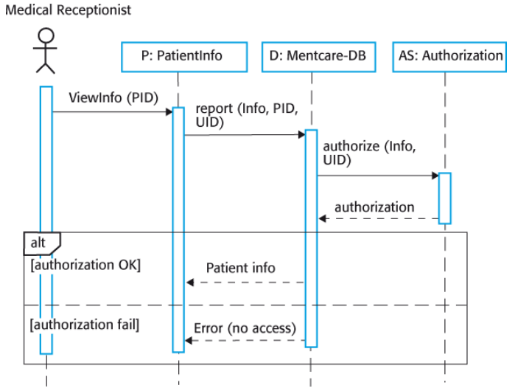
Sequence diagram for View patient information

Slide 26
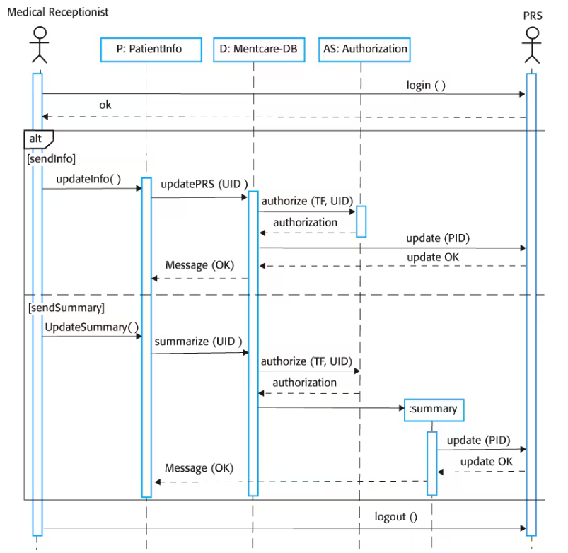
Sequence diagram for Transfer Data

Slide 27
Structural models

Slide 28
Structural models
Structural models of software display the organization of a system in terms of the components that make up that system and their relationships.
Structural models may be static models, which show the structure of the system design, or dynamic models, which show the organization of the system when it is executing.
You create structural models of a system when you are discussing and designing the system architecture.

Slide 29
Class diagrams
Class diagrams are used when developing an object-oriented system model to show the classes in a system and the associations between these classes.
An object class can be thought of as a general definition of one kind of system object.
An association is a link between classes that indicates that there is some relationship between these classes.
When you are developing models during the early stages of the software engineering process, objects represent something in the real world, such as a patient, a prescription, doctor, etc.

Slide 30
UML classes and association

Slide 31
Classes and associations in the MHC-PMS

Slide 32
The Consultation class

Slide 33
Generalization
Generalization is an everyday technique that we use to manage complexity.
Rather than learn the detailed characteristics of every entity that we experience, we place these entities in more general classes (animals, cars, houses, etc.) and learn the characteristics of these classes.
This allows us to infer that different members of these classes have some common characteristics e.g. squirrels and rats are rodents.

Slide 34
Generalization
In modeling systems, it is often useful to examine the classes in a system to see if there is scope for generalization. If changes are proposed, then you do not have to look at all classes in the system to see if they are affected by the change.
In object-oriented languages, such as Java, generalization is implemented using the class inheritance mechanisms built into the language.
In a generalization, the attributes and operations associated with higher-level classes are also associated with the lower-level classes.
The lower-level classes are subclasses inherit the attributes and operations from their superclasses. These lower-level classes then add more specific attributes and operations.

Slide 35
A generalization hierarchy

Slide 36
A generalization hierarchy with added detail

Slide 37
Object class aggregation models
An aggregation model shows how classes that are collections are composed of other classes.
Aggregation models are similar to the part-of relationship in semantic data models.

Slide 38
The aggregation association

Slide 39
Behavioral models

Slide 40
Behavioral models
Behavioral models are models of the dynamic behavior of a system as it is executing. They show what happens or what is supposed to happen when a system responds to a stimulus from its environment.
You can think of these stimuli as being of two types:
Data Some data arrives that has to be processed by the system.
Events Some event happens that triggers system processing. Events may have associated data, although this is not always the case.

Slide 41
Data-driven modeling
Many business systems are data-processing systems that are primarily driven by data. They are controlled by the data input to the system, with relatively little external event processing.
Data-driven models show the sequence of actions involved in processing input data and generating an associated output.
They are particularly useful during the analysis of requirements as they can be used to show end-to-end processing in a system.

Slide 42
An activity model of the insulin pump’s operation

Slide 43
Order processing

Slide 44
Event-driven modeling
Real-time systems are often event-driven, with minimal data processing. For example, a landline phone switching system responds to events such as ‘receiver off hook’ by generating a dial tone.
Event-driven modeling shows how a system responds to external and internal events.
It is based on the assumption that a system has a finite number of states and that events (stimuli) may cause a transition from one state to another.

Slide 45
State machine models
These model the behaviour of the system in response to external and internal events.
They show the system’s responses to stimuli so are often used for modelling real-time systems.
State machine models show system states as nodes and events as arcs between these nodes. When an event occurs, the system moves from one state to another.
Statecharts are an integral part of the UML and are used to represent state machine models.

Slide 46
State diagram of a microwave oven

Slide 47
Microwave oven operation

Slide 48
States and stimuli for the microwave oven (a)
State | Description
Waiting | The oven is waiting for input. The display shows the current time.
Half power | The oven power is set to 300 watts. The display shows ‘Half power’.
Full power | The oven power is set to 600 watts. The display shows ‘Full power’.
Set time | The cooking time is set to the user’s input value. The display shows the cooking time selected and is updated as the time is set.
Disabled | Oven operation is disabled for safety. Interior oven light is on. Display shows ‘Not ready’.
Enabled | Oven operation is enabled. Interior oven light is off. Display shows ‘Ready to cook’.
Operation | Oven in operation. Interior oven light is on. Display shows the timer countdown. On completion of cooking, the buzzer is sounded for five seconds. Oven light is on. Display shows ‘Cooking complete’ while buzzer is sounding.

Slide 49
States and stimuli for the microwave oven (b)
Stimulus | Description
Half power | The user has pressed the half-power button.
Full power | The user has pressed the full-power button.
Timer | The user has pressed one of the timer buttons.
Number | The user has pressed a numeric key.
Door open | The oven door switch is not closed.
Door closed | The oven door switch is closed.
Start | The user has pressed the Start button.
Cancel | The user has pressed the Cancel button.

Slide 50
Model-driven engineering

Slide 51
Model-driven engineering
Model-driven engineering (MDE) is an approach to software development where models rather than programs are the principal outputs of the development process.
How it works:
Create models: Developers use modeling languages such as UML (Unified Modeling Language) to describe system components, data flow, behavior, and interactions.
Transform models into code: Tools automatically convert (or compile) these models into source code that can run on a target platform (e.g., web, mobile, or embedded systems).
Generate executables: The generated code is compiled and executed on the hardware/software platform.

Slide 52
Model-driven engineering
Pros:
Higher abstraction: Developers can focus on system design and logic rather than syntax and low-level coding details.
Automation: A large part of coding and configuration is done automatically by tools.
Consistency: Because the code is generated from the model, it is less prone to human error.
Platform independence: The same model can be used to generate software for different platforms (for example, Windows, Linux, or Android) with little modification.

Slide 53
Model-driven engineering
Cons
Models are useful for abstraction and design, but they may not include all the practical details required for implementation, so developers often need to manually adjust the generated code, which reduces the benefits of automation.
The money and time saved by automatically generating code can be lost because building and maintaining the required translators (code generators) for each new platform or technology can cost more than writing the code manually.
Model-driven engineering is still at an early stage of development, and it is unclear whether or not it will have a significant effect on software engineering practice.

Slide 54
Model driven architecture
Model-driven architecture (MDA) was the precursor of more general model-driven engineering
MDA came before the broader concept of Model-Driven Engineering (MDE)
It laid the foundation for the idea that models are not just documentation
MDA is a model-focused approach.
MDA emphasizes building formal models of a system
These models use a subset of UML (Unified Modeling Language)
Instead of starting with code, developers start with structured system models
This shifts the focus from coding first ➜ to modeling first
Models describe system structure, system behavior, system interactions

Slide 55
Model driven architecture
Models at different levels of abstraction are created.
A key idea in MDA is that not all models are at the same level of detail.
such as Platform-Independent Model (PIM) and Platform-Specific Model (PSM)
Automatic Code Generation.
One of the big goals of MDA is automation
From a high-level models, in principle, it is possible to generate a working program without manual intervention.
In practice, full automation is rare, but partial code generation is widely used.

Slide 56
MDA defines models at three main levels
A computation independent model (CIM)
These model the important domain abstractions used in a system. CIMs are sometimes called domain models.
A platform independent model (PIM)
These model the operation of the system without reference to its implementation.
The PIM is usually described using UML models that show the static system structure and how it responds to external and internal events.
Platform specific models (PSM)
Converts the PIM into a design suitable for a specific technology or platform.

Slide 57
Example
Suppose we are designing an online store system:
At the CIM level: We describe customer actions like browsing products, adding to cart, and checking out.
At the PIM level: We define system functions like “Inventory Management” and “Payment Processing” using UML diagrams.
At the PSM level: We specify that this system will be implemented using Java and a MySQL database.
A tool can then generate the Java and SQL code from these models automatically.

Slide 58
MDA transformations

Slide 59
Multiple platform-specific models

Slide 60
Key points
A model is an abstract view of a system that ignores system details. Complementary system models can be developed to show the system’s context, interactions, structure and behaviour.
Context models show how a system that is being modeled is positioned in an environment with other systems and processes.
Use case diagrams and sequence diagrams are used to describe the interactions between users and systems in the system being designed. Use cases describe interactions between a system and external actors; sequence diagrams add more information to these by showing interactions between system objects.
Structural models show the organization and architecture of a system. Class diagrams are used to define the static structure of classes in a system and their associations.

Slide 61
Key points
Behavioral models are used to describe the dynamic behavior of an executing system. This behavior can be modeled from the perspective of the data processed by the system, or by the events that stimulate responses from a system.
Activity diagrams may be used to model the processing of data, where each activity represents one process step.
State diagrams are used to model a system’s behavior in response to internal or external events.
Model-driven engineering is an approach to software development in which a system is represented as a set of models that can be automatically transformed to executable code.

